Slide 1

Sensor and Sensing Technology
Presenting to
Professor Zhang, Yikui
School Computer Software
Presenting by
MOHAMMED ALGAMALI 6118000082
Taiabur Rahman 6218000126
Mansoor Saleh 6218000158

Slide 2
third eye Smart shoes for Blind MAN

Slide 3
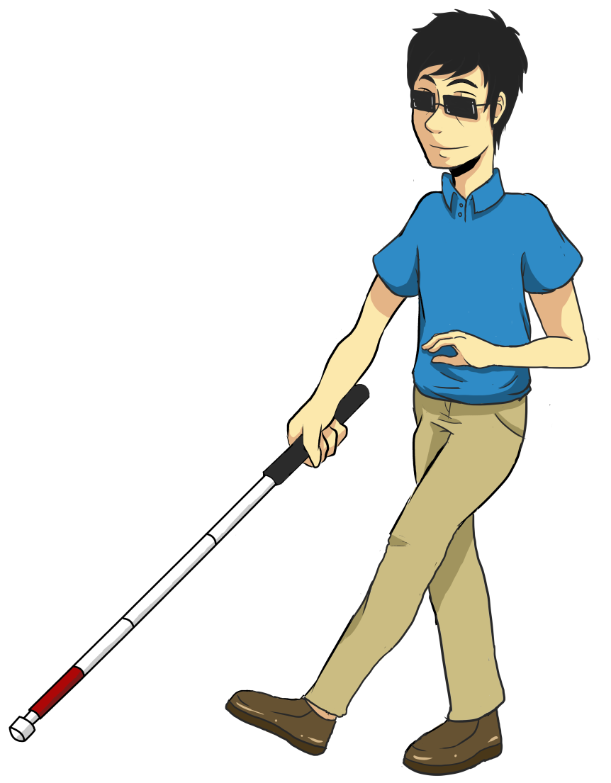
Real-life effect
This project is intended to be developed as tool or aid that will help blind man in moving, by mean facilitates the life of the blind man.
The dependency on others is reduced and these people can become more self-reliant.
Can be used by people with poor eyesight.
Image source: internet

Slide 4
Third eye project feature
Directions Guide
Speech Guide (Alert) simulate with software interface
Sound buzzer (Alert)
Remote Tracking (Extension)
Image source: internet

Slide 5
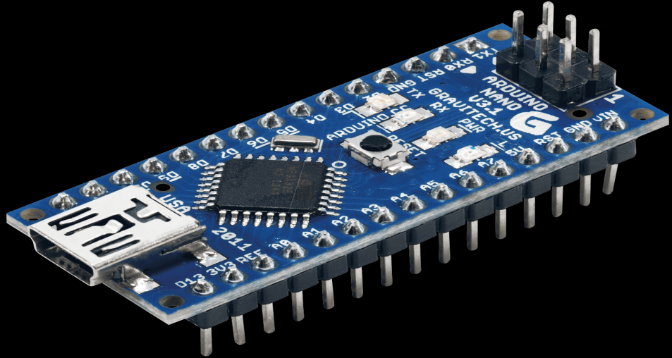
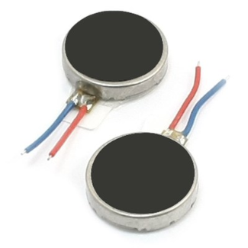

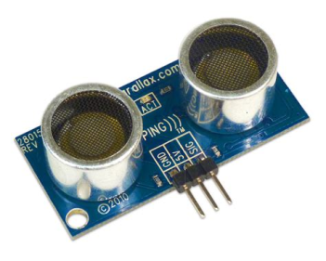
Require Component
Arduino Nano Board
Ultrasonic Sensor
Acceleration Sensor
Headphone/buzzer
Vibration motor
Image source: internet

Slide 6
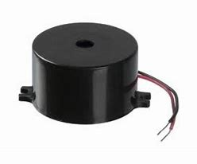

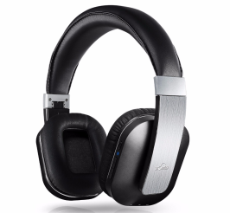

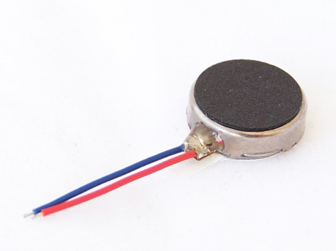
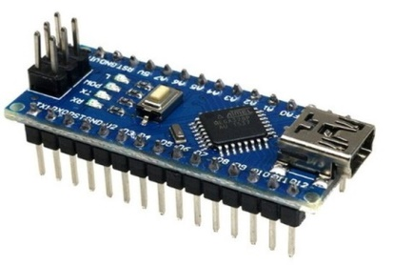

How to work it
Input
Processing
Output
Object
Sensor
Arduino Nano
Sound & vibration
Image source: internet

Slide 7
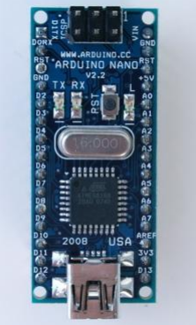
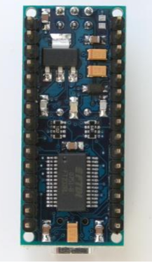
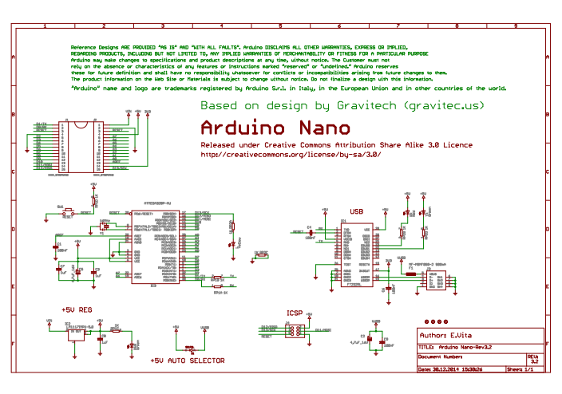
Arduino nano Board
Arduino Nano Front
Arduino Nano
Image source: internet

Slide 8
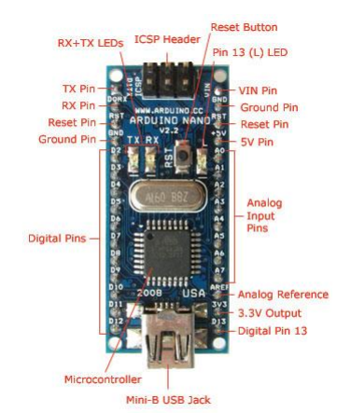
Arduino nano Board
Specifications:
Microcontroller : Atmel ATmega168 or ATmega328
Operating Voltage : 5 V
Input Voltage : 7-12 V
Digital I/O Pins :14 (of which 6 provide PWM output)
Analog Input Pins : 8
DC Current per I/O Pin : 40 mA
Flash Memory : 16 KB
Clock Speed : 16 MHz
Image source: internet

Slide 9
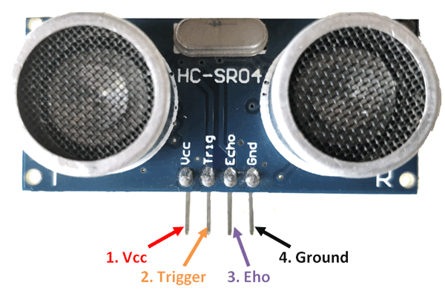
Ultrasonic Sensor
Specifications:
Ultrasonic Ranging Module HC - SR04
Operating Voltage : 5 V
Accuracy : 3mm
Measuring angle covered : <15°
Operating Current : <15mA
Operating Frequency : 40Hz
Image source: internet

Slide 10
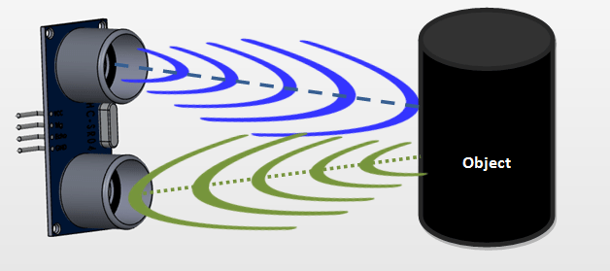
Ultrasonic Sensor
Pin Configuration:
VCC: The Vcc pin powers the sensor, typically with +5V
Tigger: Trigger pin is an Input pin. This pin has to be kept high for 10us to initialize measurement by sending US wave.
Echo: Echo pin is an Output pin. This pin goes high for a period of time which will be equal to the time taken for the US wave to return back to the sensor.
Ground: This pin is connected to the Ground of the system
Image source: internet

Slide 11
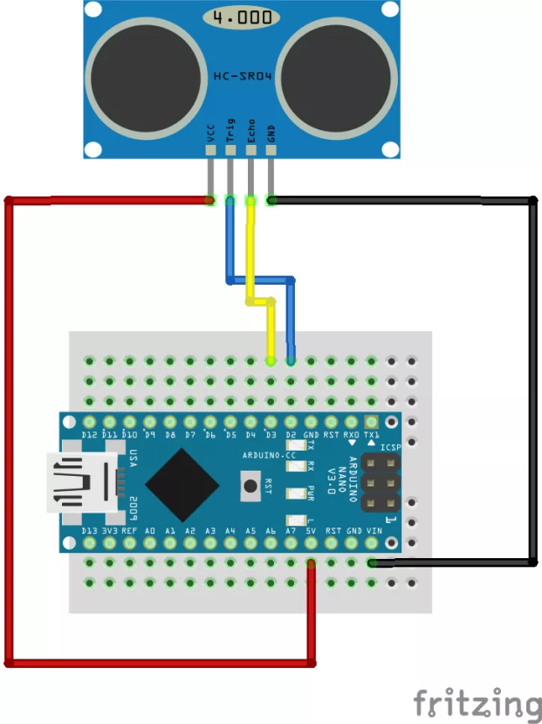
Ultrasonic Sensor
Arduino Nano Pin | Ultrasonic Sensor Pin
5v | VCC
GND | GND
I/O pin | GND
I/O pin | ECHO
Image source: internet

Slide 12
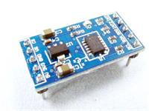
Accelerometer Sensor
Digital Output: I2C
Operating Voltage : 5V/3.3V
Low Power Consumption
Faster load the appropriate speed
Ideal for noisy power environment
Pin Standard 100mil (2.54mm)
Image source: internet

Slide 13
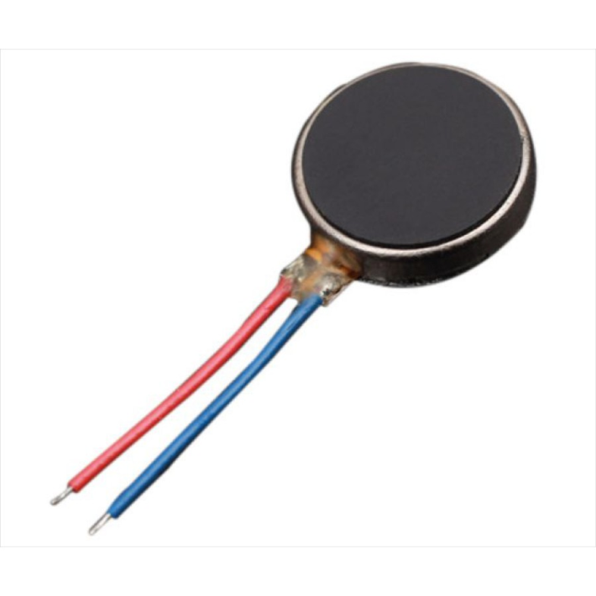
Vibrating Disk Motor
Motor construction : 10- Flat coreless vibration motor
Coil construction : Flat coreless core
Rated Load : Vibration weight
Rotation direction : CCW or CW
Motor position: Any position available
Voltage range for use: DC 2.5V - 3.5V
Allowable temperature range: -20ºC to 70ºC
Image source: internet

Slide 14
Project Software (interface)
Image source: internet

Slide 15
Mac and Windows Interface
Using software to control the hardware device ,the speech guide and power button will be simulated with this Mac & Win application interface.
Mac interface program: Xamarin Cocoa C# & Xcode.
Windows interface program: Visual studio c#.
Image source: internet

Slide 16
What has been done!?:
All the sensors that we got, were successfully tested.
Program Arduino with visual C# in PC and Xamarin C# were successfully tested.
Image source: internet

Slide 17
Connect Arduino with Mac c# programing
using System.IO.Ports;
myPort = new SerialPort();
myPort.BaudRate = 9600; myPort.PortName = "/dev/cu.wchusbserial1410"; myPort.Open();
Image source: internet

Slide 18
Connect Arduino with windows c# program
using System.IO.Ports;
myPort = new SerialPort();
myPort.BaudRate = 9600; myPort.PortName = COM4"; myPort.Open();
Image source: internet

Slide 19
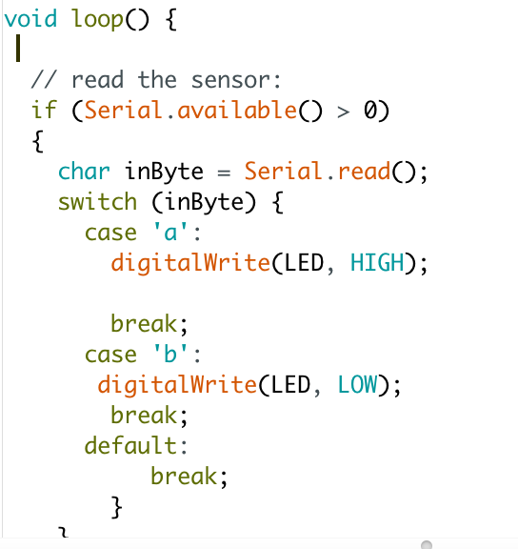
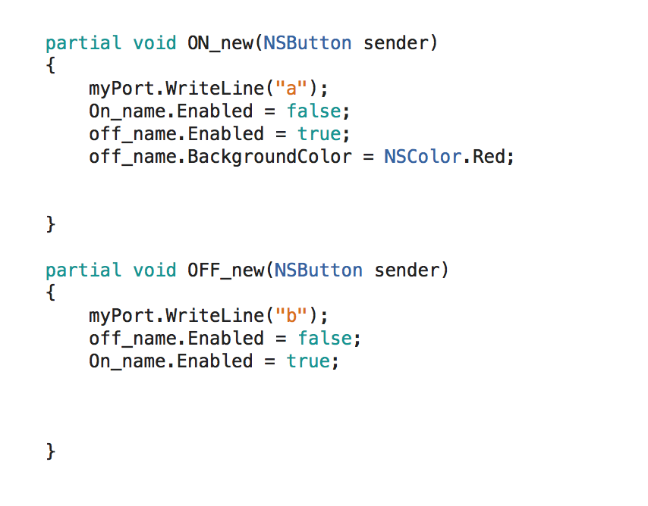
Testing c# program communicate with Arduino
Image source: internet

Slide 20
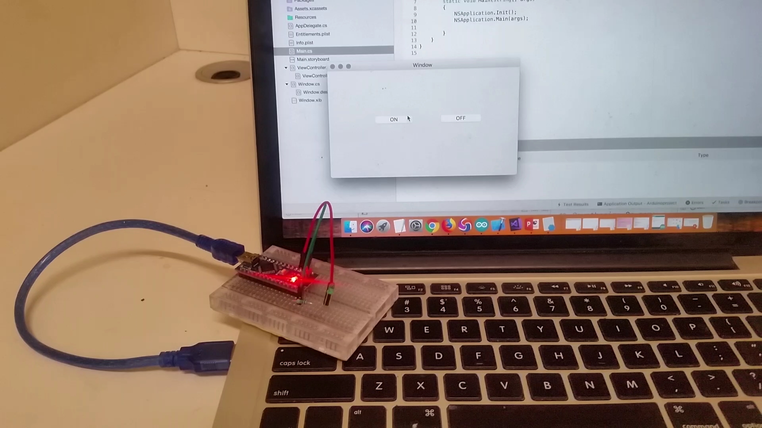
Testing c# program communicate with Arduino (Video)
Image source: internet

Slide 21
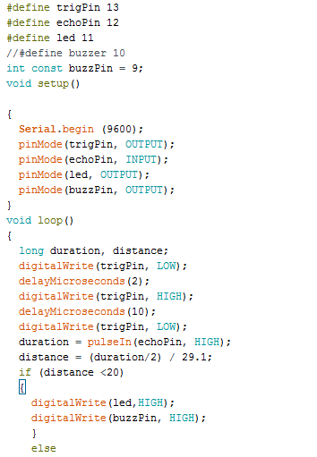
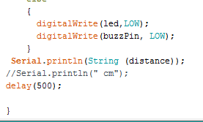
Arduino Code for the Project
Image source: internet

Slide 22
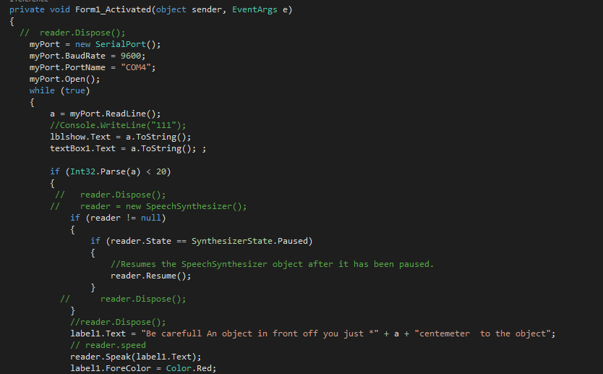
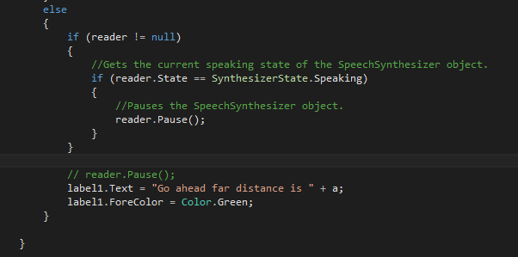
C# Programming interface for the Project
Image source: internet

Slide 23
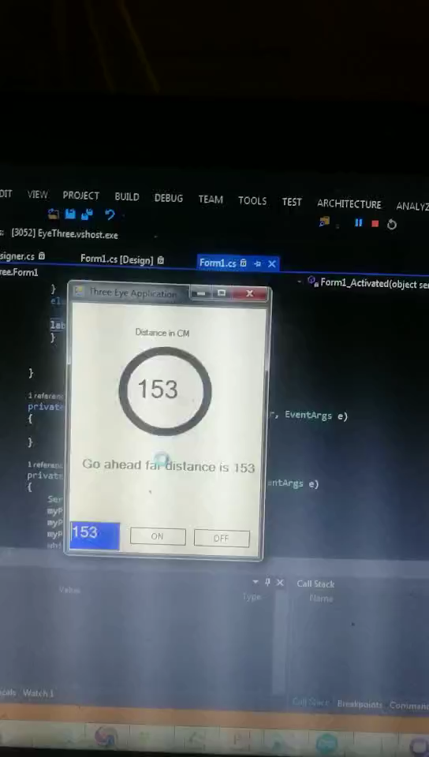
Testing c# program communicate with Arduino (Video)
Image source: internet

Slide 24

Project Mobile App
Image source: internet

Slide 25
Third eye project App feature
Speech(Sound) Alarms instead of buzzer
Sound and Vibration for 5 seconds ( Alarms)
Connected to Bluetooth (Speech- notification)
Disconnected from Bluetooth (Speech- notification)
Image source: internet

Slide 26
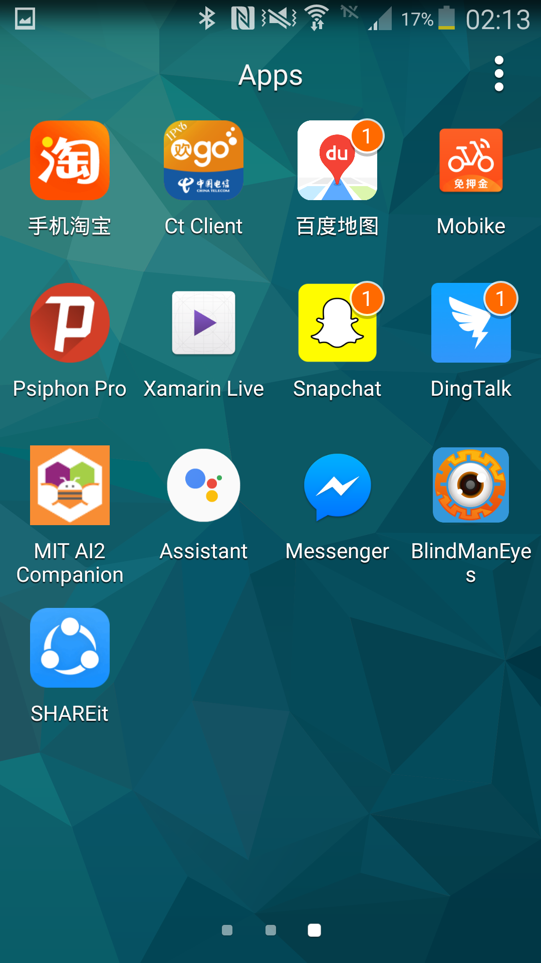
Third eye project icon
Image source: internet

Slide 27

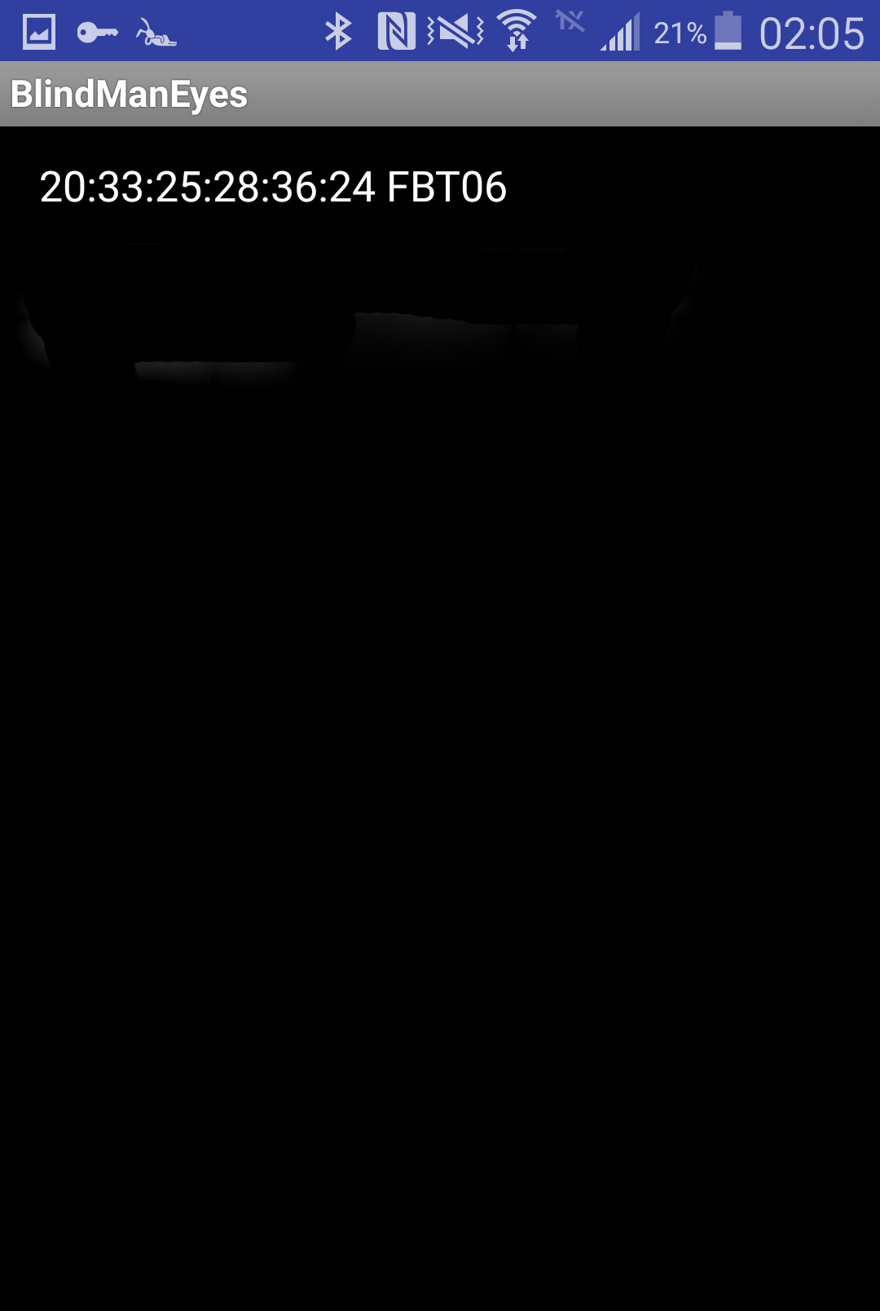
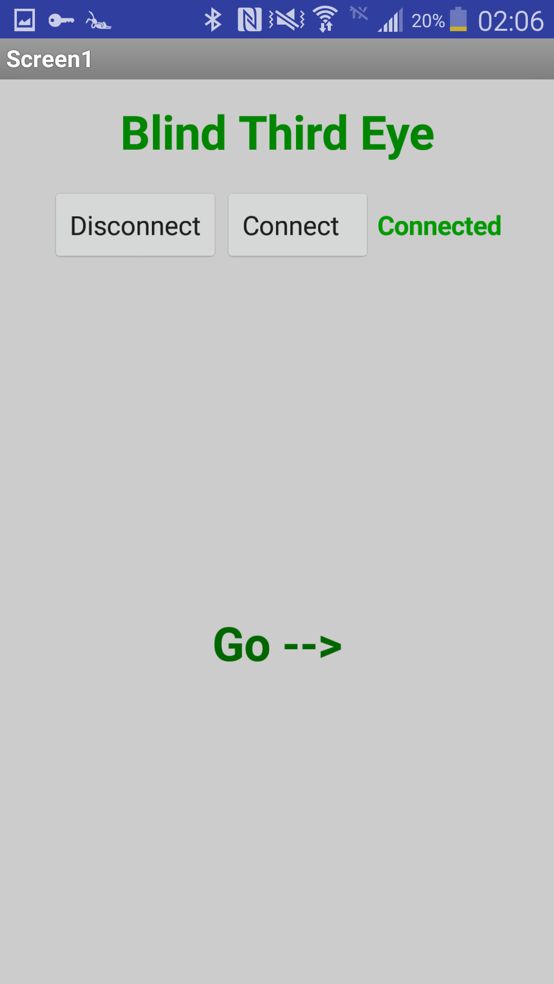
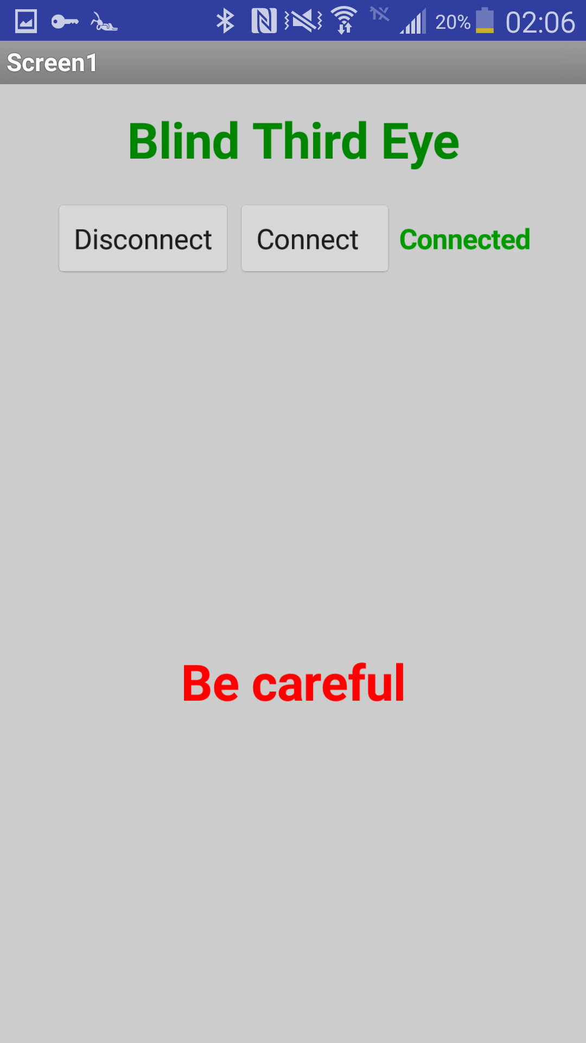
Third eye project App interface
Image source: internet

Slide 28
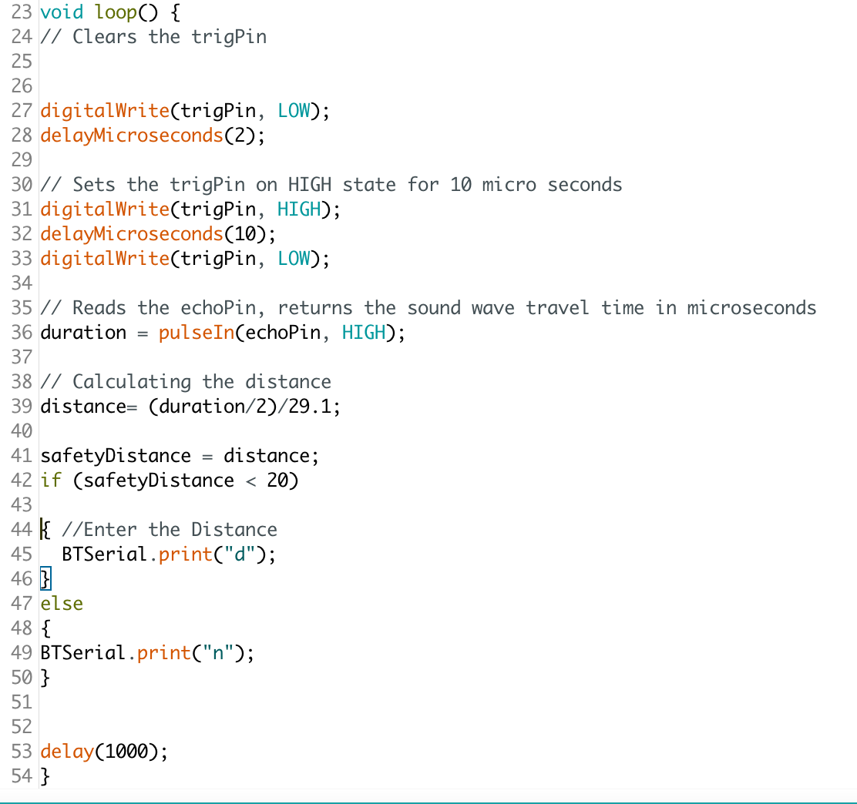
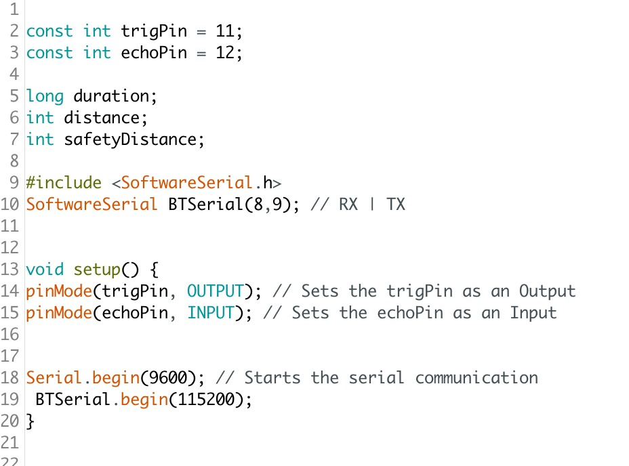
Third eye project Arduino programming
Image source: internet

Slide 29
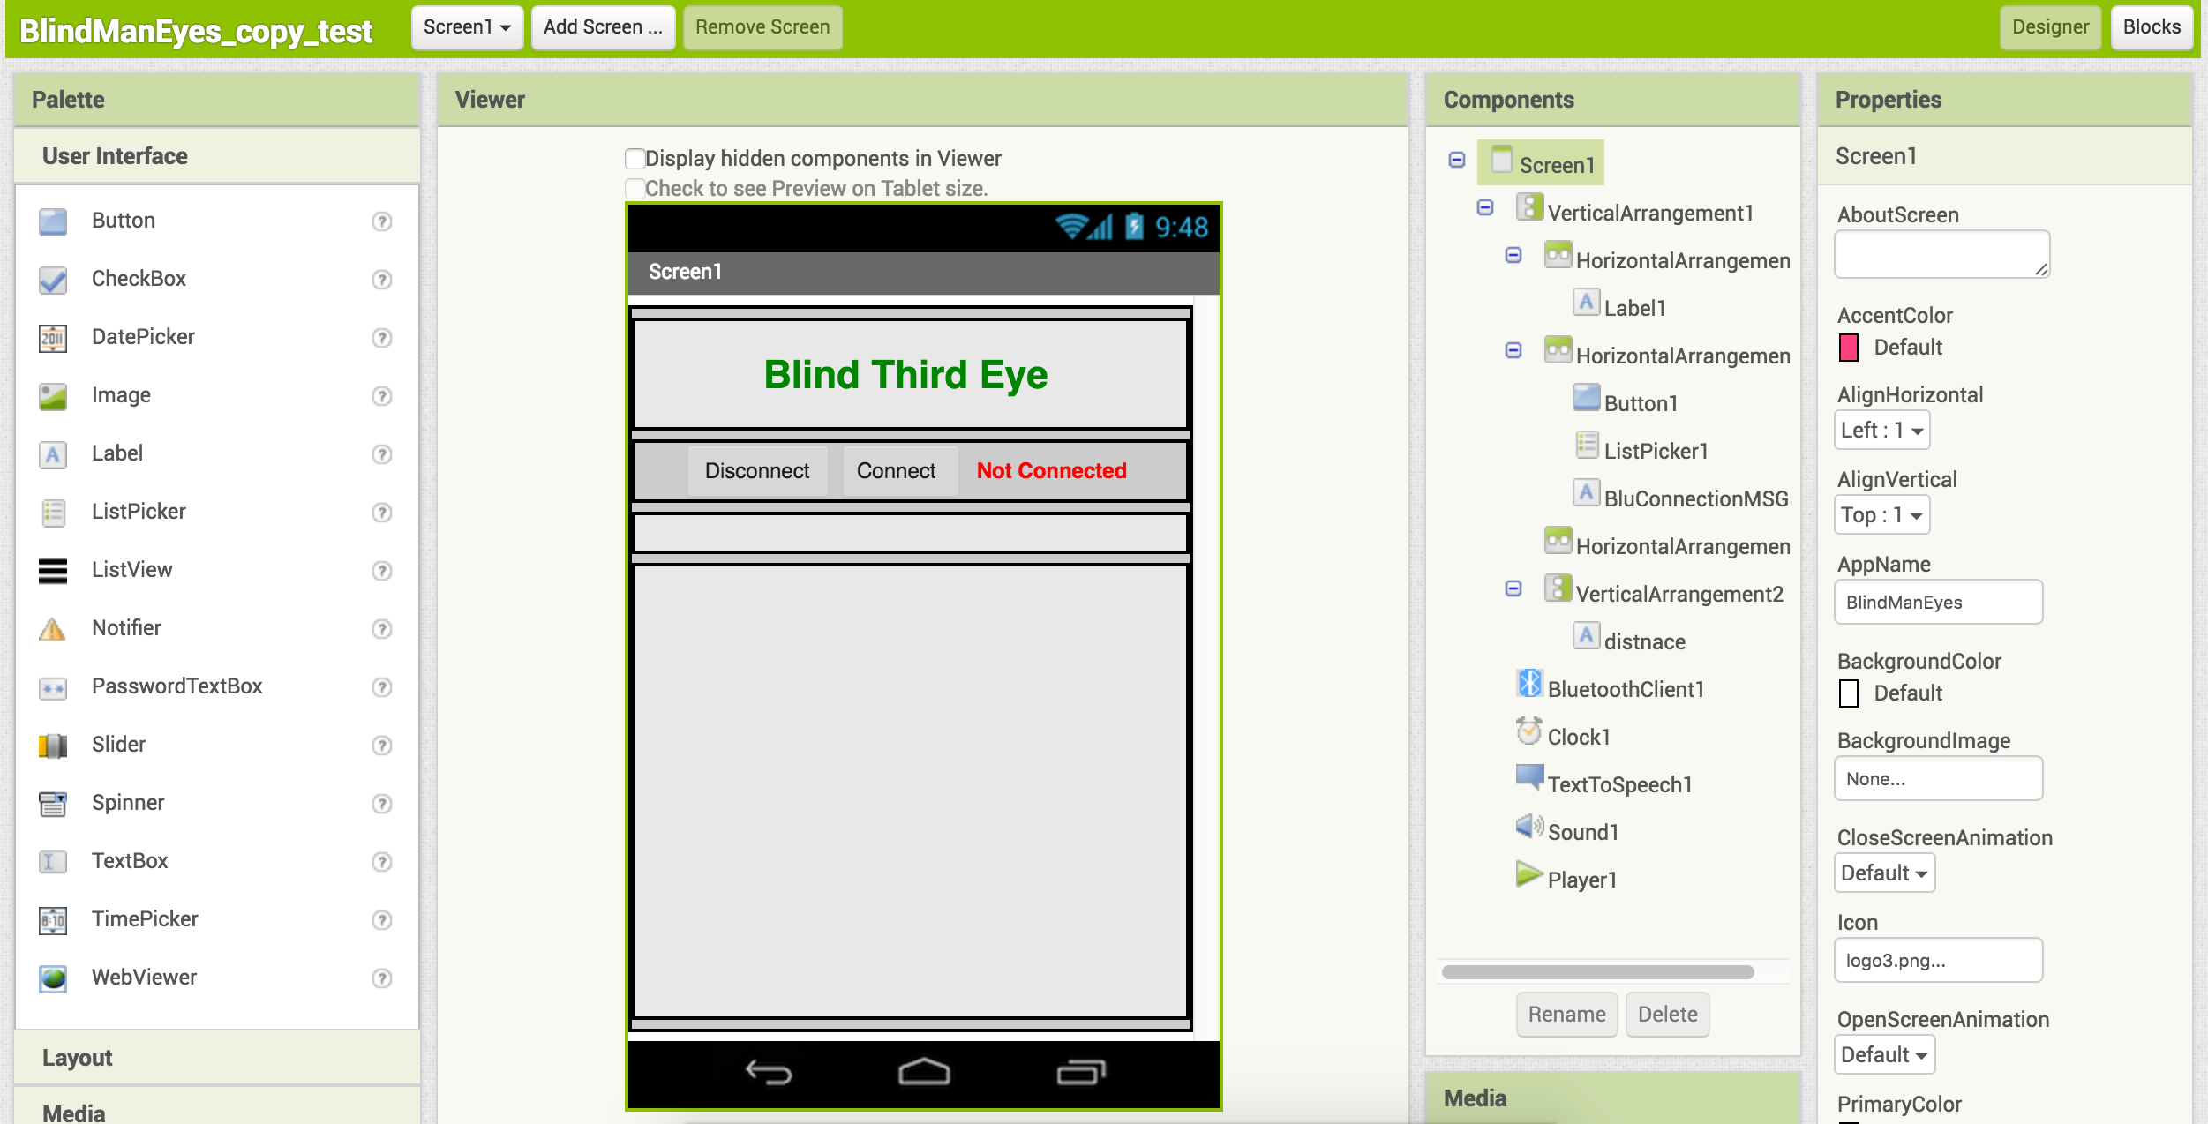
Appinventor programming-design interface
Image source: internet

Slide 30
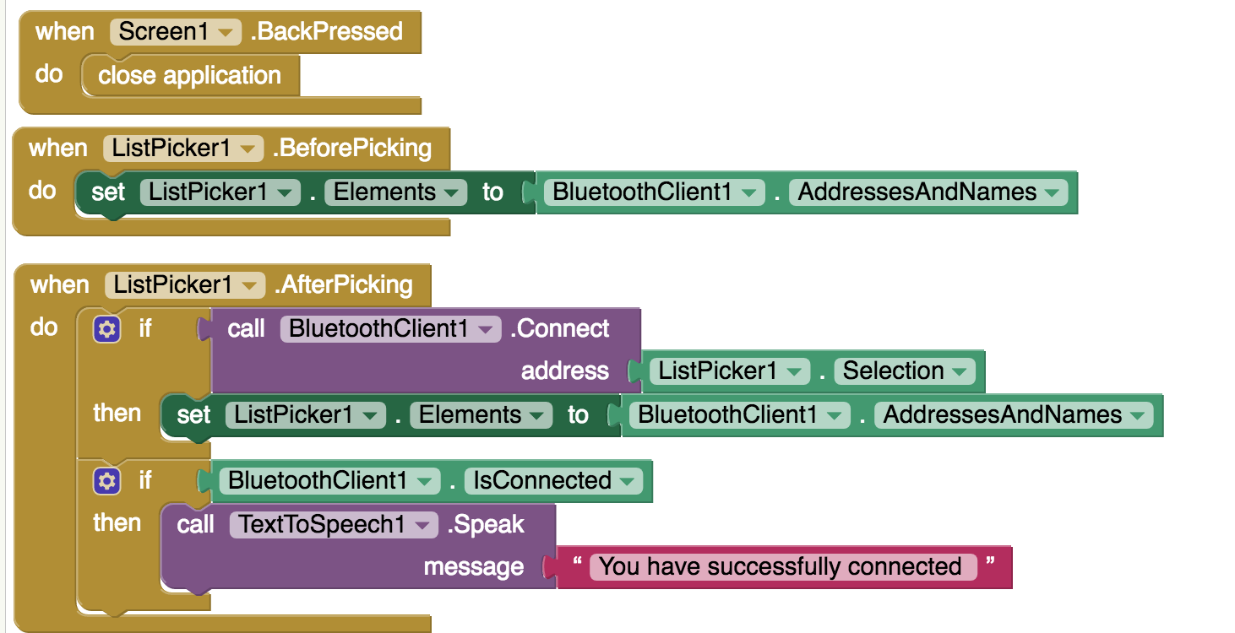
Third eye project Appinventor programming
Image source: internet

Slide 31
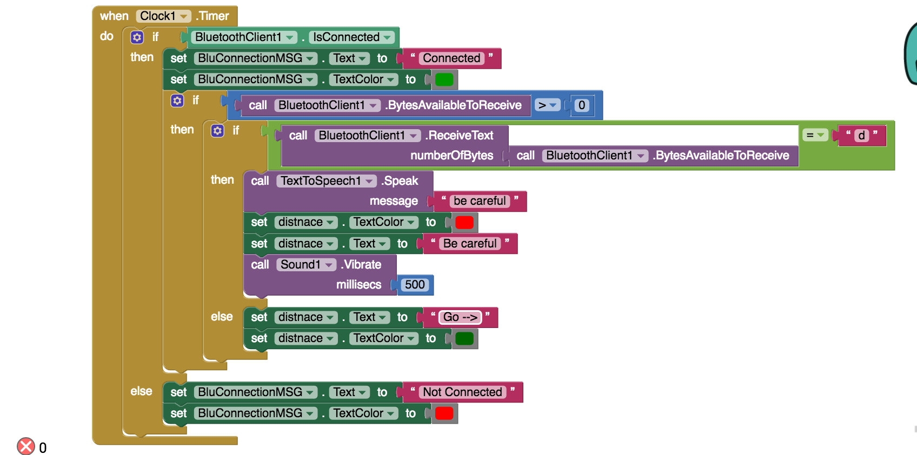
Appinventor programming-blocks
Image source: internet

Slide 32
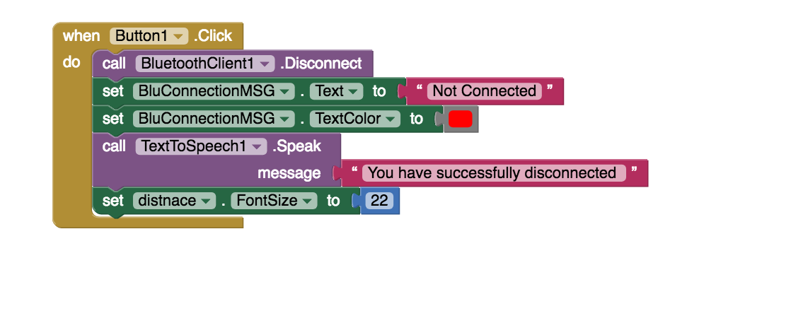
Appinventor programming-blocks
Image source: internet

Slide 33

FAQ
Image source: internet

Slide 34

Suggestion Box
Image source: internet

Slide 35

Thank you

